Slide 1
South Florida VMUG User Conference Operationalizing Public Cloud with VMware Cloud Management
Christopher Kusek
Multi-Cloud Management Specialist
@cxi
thepragmatictech.com
linkedin.com/in/christopherkusek

Slide 2
Resources
Essential Resources for all things vRealize!
VMwareOpsGuide - https://www.vmwareopsguide.com
VMwareOpsGuide GitHub - https://github.com/TheNewStellW/vmware-operations-guide
All Things vRealize Resources - https://vrealize.vmware.com
VMware PathFinder - https://pathfinder.vmware.com
VMware CODE Sample Exchange - https://code.vmware.com/samples
Brock Petersons Blog - https://www.brockpeterson.com
ThePragmaticTech Blog - https://thepragmatictech.com/
REGISTER for VMWORLD! - https://www.vmworld.com

Slide 3
VMware Ops Guide
A 500+ Page book that is constantly being updated, available in multiple languages!

Slide 4
VMware Operations Guide on GitHub!
Feel free to join us in contributing content to this living guide!

Slide 5
vRealize and all things vRealize!
My favorites are the ‘Samples’!

Slide 6
VMware Pathfinder!
How to start your path to Digital Transformation for all things VMware!

Slide 7
VMware CODE Sample Exchange
Dashboards, Super Metrics and More!

Slide 8
Brock Peterson’s Blog!
Your One Stop Shop for all things vRealize!

Slide 10
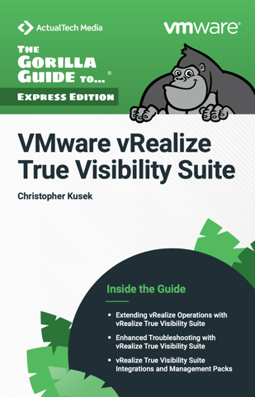
Free Download of vRealize Operations True Visibility Suite book

Slide 11
Demo Demo Demo!
Where we’ll get started!
vRealize Operations Cloud
Application Introspection and Visibility with TVS and VRNI
What if Analysis
Operationalization of moving your application to Public Cloud
Dashboards oh my!
Standing up new applications native in ‘any cloud’
Day 2 Operations to Day 200 Operations!
Whatever else we have time for!

